Slide 1
Nuclear Fission

Slide 2
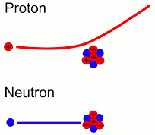
Neutrons vs. Alpha Particles
In the early 1900s, nuclear physicists did experiments by firing alpha particles at atoms of different elements.
This produced interesting results with small nuclei, but the alpha particles were more strongly repelled by larger nuclei and collisions did not occur.
When James Chadwick discovered neutrons in 1932, scientists were able to use them to artificially transmute heavier elements.
Since neutrons have no charge, they are not repelled by a nucleus.

Slide 3
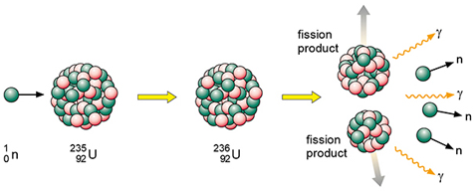
Fission
Nuclear fission occurs when an atomic nucleus splits into two or more smaller nuclei.
This is often triggered by the absorption of a neutron.
Nuclides that are capable of undergoing fission are said to be fissile.
Most fissile nuclides are elements with high atomic numbers (e.g. uranium-235, plutonium-239).
Fission, like radioactive decay, is often a random process: many different combinations of fission products are possible.
Vocabulary
nu·clide (noun) a type of atom specified by its atomic number, atomic mass, and energy state
Notes:
Nuclide is similar in meaning to isotope, but the term is slightly broader and used more when discussing the nuclear properties of atoms (as opposed to their chemical properties). Isotopes have equal Z, but other relationships exist between nuclides: isotones are nuclides with equal N, isobars have equal A. Technetium-99 and technetium-99m are nuclear isomers: nuclides with equal Z and A but different energy states.

Slide 4
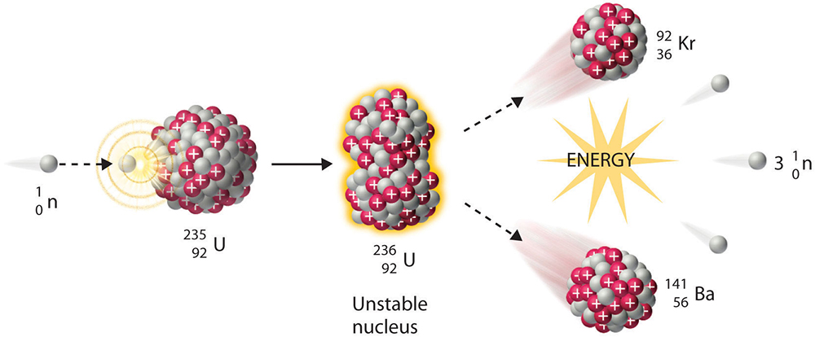
Release of Neutrons during Fission
In addition to new nuclei (called daughter nuclei or fission fragments), nuclear fission can also release neutrons.
For example, when a uranium-235 nucleus absorbs a neutron, it can split into barium-141 and krypton-92. However, it also releases three neutrons and a significant amount of energy.
This can be written as an equation:
$$\begin{matrix}1 \\ 0\end{matrix}\text{n}+\begin{matrix}235 \\ 92\end{matrix}\text{U}→\begin{matrix}236 \\ 92\end{matrix}\text{U}→\begin{matrix}141 \\ 56\end{matrix}\text{Ba}+\begin{matrix}92 \\ 36\end{matrix}\text{Kr}+3 \begin{matrix}1 \\ 0\end{matrix}\text{n}$$

Slide 5
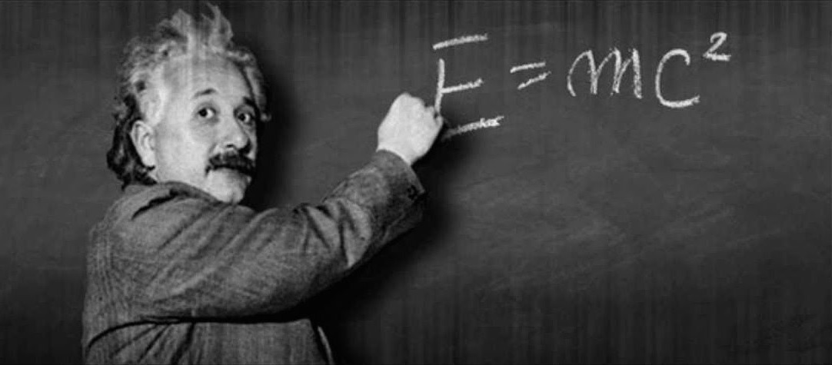
Mass-Energy Balance
In 1905, Einstein determined that the mass of a particle is directly proportional to its energy, according to the now-famous equation
$$E=mc^{2}$$
This means that any reaction that absorbs or releases energy must be accompanied by a change in mass.
This change is far too small to detect in chemical reactions, but is significant in nuclear reactions because the amount of energy released is much greater.

Slide 6
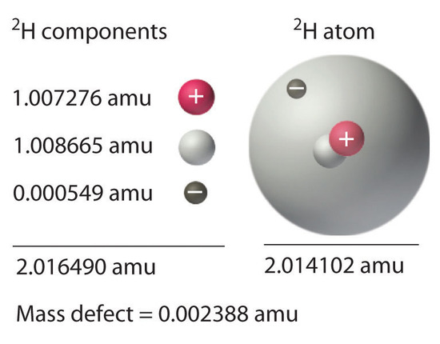
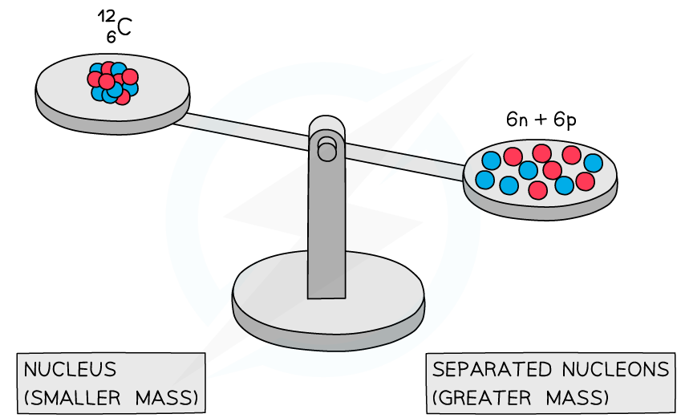
Release of Energy during Fission
To separate a nucleus into individual nucleons (protons and neutrons), a significant amount of energy would be required.
This amount of energy is called the nuclear binding energy of the nucleus.
Adding this energy would increase the mass of the nucleons according to $ΔE=Δmc^{2}$.
This difference in mass is the mass defect of the nucleus.
Vocabulary
amu (unit) – atomic mass unit, u a unit of mass equal to 1.66 × 10⁻²⁷ kg; protons / neutrons have a mass of ≈1 u Δ (Greek letter) – Delta used as a mathematical symbol to mean ‘change in’

Slide 7
Sample Problem #1
Calculate the nuclear binding energy of a lithium-7 nucleus (${}_{3}^{7}{\text{Li}}$) in joules and megaelectronvolts (MeV).
m_{Li} = 7.01436 u
m_{p} = 1.00728 u
m_{n} = 1.00867 u
$$Δm=\text{mass} \text{of} \text{nucleons}−\text{mass} \text{of} \text{nucleus} \\ Δm=\left(3m_{\text{p}}+4m_{\text{n}}\right)−m_{\text{Li}} \\ Δm=\left(3×1.00728+4×1.00867\right)−7.01436 \\ Δm=0.04216 \text{u}$$
Vocabulary
eV (unit) – electronvolt a unit of energy equal to 1.60 × 10⁻¹⁹ J; the amount of kinetic energy gained by a single electron accelerating though a potential difference of 1 V

Slide 8
Sample Problem #1
Calculate the nuclear binding energy of a lithium-7 nucleus (${}_{3}^{7}{\text{Li}}$) in joules and megaelectronvolts (MeV).
m_{Li} = 7.01436 u
m_{p} = 1.00728 u
m_{n} = 1.00867 u
$$Δm=0.04216 \text{u} \\ 1 \text{u}=931 \text{MeV} \\ ΔE=0.04216×931=39.25096 \\ ΔE=39.3 \text{MeV}$$
$$1 \text{eV}=1.60×{10}^{−19} \text{J} ∴1 \text{MeV}=1.60×{10}^{−13} \text{J} \\ ΔE=39.25096×1.60×{10}^{−13} \\ ΔE=6.28×{10}^{−12} \text{J}$$
Vocabulary
eV (unit) – electronvolt a unit of energy equal to 1.60 × 10⁻¹⁹ J; the amount of kinetic energy gained by a single electron accelerating though a potential difference of 1 V

Slide 9
Sample Problem #2a-b
Thorium-based nuclear power plants take advantage of the fission of uranium-233, which is produced from thorium decay. The thorium fuel cycle can be represented by the following equation:
$$\begin{matrix}1 \\ 0\end{matrix}\text{n}+\begin{matrix}232 \\ 90\end{matrix}\text{Th}→\begin{matrix}233 \\ 90\end{matrix}\text{Th}→\begin{matrix}233 \\ 91\end{matrix}\text{Pa}→\begin{matrix}233 \\ 92\end{matrix}\text{U}$$
What type of decay does the thorium-233 undergo to form protactinium-233?
β⁻ decay
What type of decay does the protactinium-233 undergo to form uranium-233?
β⁻ decay

Slide 10
Sample Problem #2c
When used as a fuel, a uranium-233 nucleus absorbs a neutron to form an unstable uranium-234 nucleus, which can then decay into zirconium and tellurium:
$$\begin{matrix}1 \\ 0\end{matrix}\text{n}+\begin{matrix}233 \\ 92\end{matrix}\text{U}→\begin{matrix}93 \\ 40\end{matrix}\text{Zr}+\begin{matrix}138 \\ 52\end{matrix}\text{Te}+3 \begin{matrix}1 \\ 0\end{matrix}\text{n}$$
m_{n} = 1.674929445 × 10⁻²⁷ kg
m_{U-233} = 3.869716824 × 10⁻²⁵ kg
m_{Zr-93} = 1.542749382 × 10⁻²⁵ kg
m_{Te-193} = 2.290370146 × 10⁻²⁵ kg
Calculate the amount of energy released by the above nuclear reaction in eV.
$$Δm=\left(m_{\text{n}}+m_{\text{U}\text{−233}}\right)−\left(m_{\text{Zr}\text{−93}}+m_{\text{Te}\text{−138}}+3m_{\text{n}}\right) \\ Δm=3.0987071×{10}^{−28} \text{kg}$$

Slide 11
Sample Problem #2c
$$Δm=3.0987071×{10}^{−28} \text{kg} \\ ΔE=Δmc^{2} \\ ΔE=3.0987071×{10}^{−28}×{\left(3.00×{10}^{8}\right)}^{2} \\ ΔE=2.7888364×{10}^{−11} \text{J}$$
$$1 \text{eV}=1.60×{10}^{−19} \text{J}$$
$$ΔE=\frac{2.7888364×{10}^{−11}}{1.60×{10}^{−19}}=1.7430227×{10}^{8} \\ ΔE=1.74×{10}^{8} \text{eV}=174 \text{MeV}$$

